Slide 1


Parallel Programming
Faculty of Electronics, Telecommunications and Information Technology
On embedded multi-core
System ESP32
Teachers:
Aurel GONTEAN
Alexandru SFIRAT
Students:
Marian-Claudiu BELEAN
Franz Joseph PAL

Slide 2
Content
i. Introduction
ii. Problem definition
iii. Basic Concept of Parallel Programming
iv. Parallel Programming Architecture

Slide 3
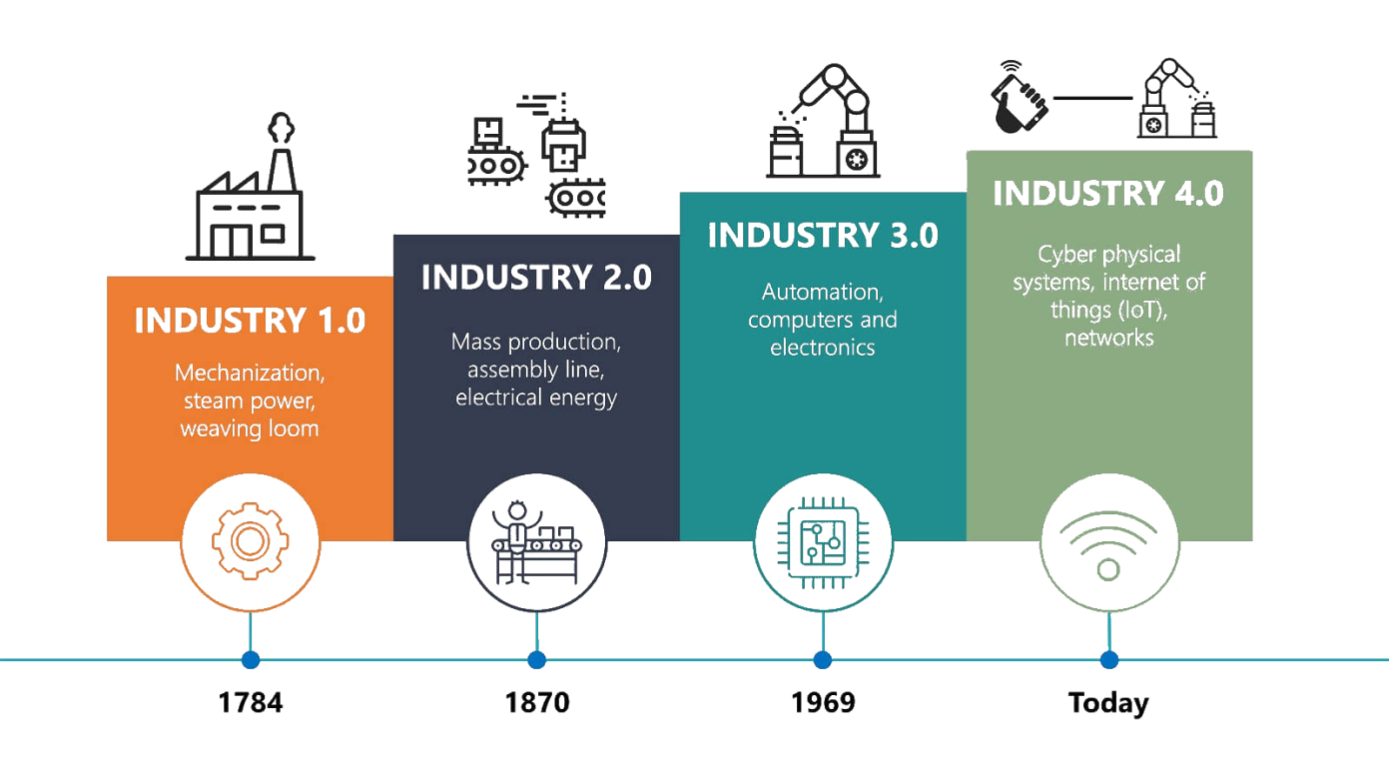
Introduction
Multicore Systems are becoming increasingly popular as part of digitalization and Industry 4.0 important role in data processing and process automation

Slide 4
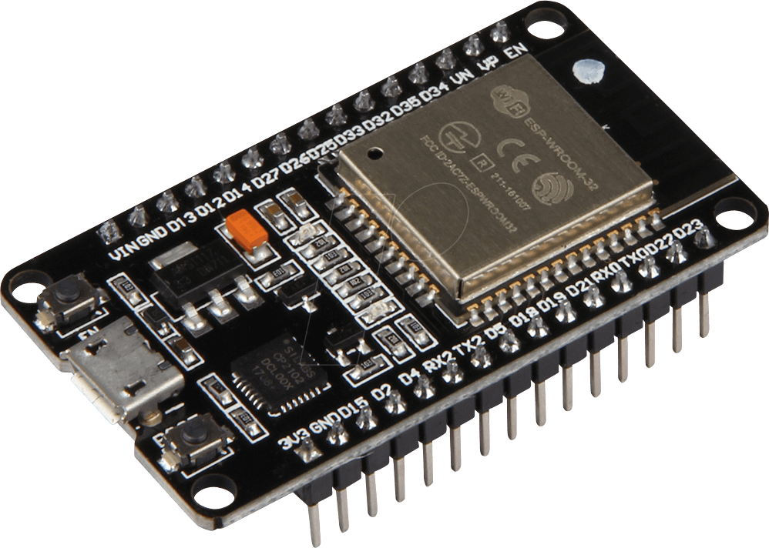
Problem Definition
ESP32 it is an multi-core embedded hardware platforms that reduces execution time and power consumption with it’s ability to develop advanced parallel computing softwares.
In order to develop an optimal solution, the hardware platform must be included in addition to the mathematical model of the problem itself.

Slide 5
Basic Concept of Parallel Programming
The aim of parallelism is to reduce the execution time and is one of the most important objectives in concurrency to make applications more efficient.

Slide 6
Basic Concept of Parallel Programming

Slide 7
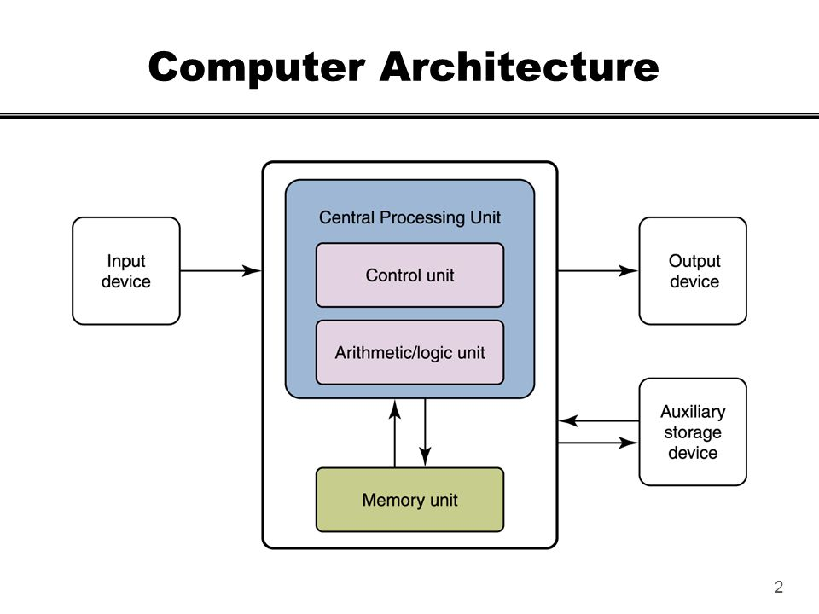
Parallel Programming Architecture
Computer architecture structure of a computer. Computer architect's task is to write an suitable program code for the machine, understanding all the factors like state-of-the-art technologies at each design level and changing those designs tradeoffs for their specific applications

Slide 8
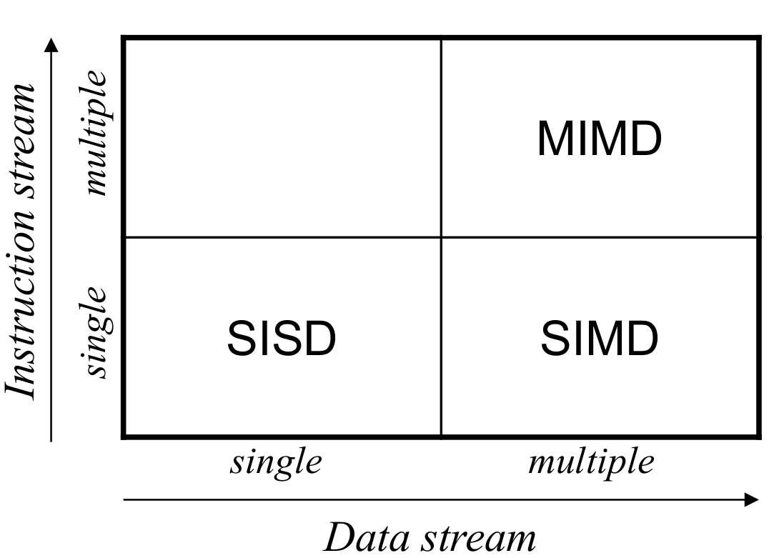
Parallel Programming Architecture
Flynn's classication a scheme which is based on the notion of information stream
“Stream” defines a sequence or flow containing one of both existent types of information which flows and are operated into a processor: instructions or data
Types of Parallelism:
Bit-level parallelism
Instruction-level parallelism
Task/Thread parallelism

Slide 9
Thank you!

